Slide 1
HEAT AND MASS TRANSFER
COMPOSITE SYSTEMS
P.TAMILSELVAN
ASSOCIATE PROFESSOR
SMBS

Slide 2
Heat Transfer Applications
• Heat transfer is commonly encountered in engineering systems and other aspects of life, and one does not need to go very far to see some
1.Air conditioners
2.Refrigeration systems
3.Power plants
4.Car radiators
5.Circuit boards

Slide 3
Course Structure
Heat transfer-Modes
Conduction
Convection
Composite systems

Slide 4
Heat transfer defined
Heat is energy in motion due to a difference in temperature and is experimentally observed and measured

Slide 5
Different types of heat transfer processes are called different modes of heat transfer
Conduction heat transfer is due to a temperature gradient in a stationary medium or media
Convection heat transfer occurs between a surface and a moving fluid when they are at different temperatures
Radiation heat transfer occurs due to emission of energy in the form of electromagnetic waves by all bodies above absolute zero temperature
Net radiation heat transfer occurs when there exists a temperature difference between two or more surfaces emitting radiation energy

Slide 6
Three modes of heat transfer
Conduction
Solids
Fluids (liquids and gases)
Convection
Fluids (liquids and gases)
Thermal radiation
Gases, liquids, and a vacuum

Slide 7
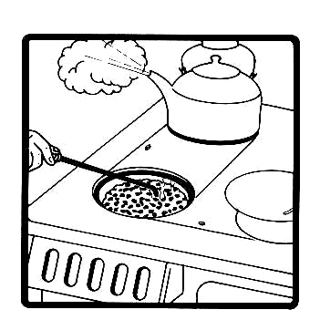
Conduction Heat Transfer

Slide 8
Conduction heat transfer
The transfer of energy in a solid or fluid via molecular contact without bulk motion
Solids—Lattice vibrations; physical models at atomic level for prediction
Fluids—Molecular collisions; atomic level models

Slide 9
Conduction in solids
Empirical basis for relating heat flux, q, to temperature difference.
T₀
Observed temperature
distribution in the solid
T₁ < T₀
x

Slide 10
The Fourier Law
The relation between the heat flux, q, and the gradient of temperature is called the constitutive relation.
The proportionality constant, k, is defined as the thermal conductivity, a thermophysical property.

Slide 11
Thermal conductivity
The thermal conductivity, k, is a material property and is called a thermophysical property.

Slide 12
Thermal Conductivity
• Specific heat Cp is a measure of a material’s ability to store thermal
energy. For example, Cp = 4.18 kJ/kg·°C for water and Cp = 0.45
kJ/kg·°C for iron at room temperature, which indicates that water
can store almost 10 times the energy that iron can per unit mass.
• Likewise, the thermal conductivity k is a measure of a material’s
ability to conduct heat. For example, k = 0.608 W/m·°C for water
and k = 80.2 W/m·°C for iron at room temperature, which indicates
that iron conducts heat more than 100 times faster than water can.
• Thus water is a poor heat conductor relative to iron, although
water is an excellent medium to store thermal energy

Slide 13
Relative values of k
Metals k/k_{silver}
Silver 1
Gold 0.7
Copper 0.93
Aluminum 0.86
Brass (70% Cu:30% Ni) 0.33
Platinum, Lead 0.25
Mild steel (0.1% Cu), Cast iron 0.12
Bismuth 0.07
Mercury 0.04

Slide 14
Relative values of k. . .
Non-Metals k/k_{silver}
Air 0.19
Water 0.0014
Granite, Sandstone 0.011
Average rock 0.012
Limestone 0.007
Ice 0.015
Glass (crown) 0.0058

Slide 15
Relative values of k. . .
Non-Metals k/k_{silver}
Concrete (1:2:4) 0.0042
Brick 0.0038
Snow (fresh or average) 0.005
Soil (sandy, dry) 0.002
Soil (8% moist) 0.0033
Wood 0.0045

Slide 16
Range of Thermal Conductivity
• The thermal conductivities of gases such as air vary by a factor of 104 from those of pure metals such as copper.
• Note that pure crystals and metals have the highest thermal conductivities, and gases and insulating materials the lowest.

Slide 17
The thermal conductivity of a substance is normally highest in the solid phase and lowest in the gas phase.
• Unlike gases, the thermal conductivities of most liquids decrease with increasing
temperature, with water being a notable exception.
• In solids, heat conduction is due to two effects: the lattice vibrational waves induced by the vibrational motions of the molecules positioned at relatively fixed positions in a periodic manner called a lattice, and the energy transported via the free flow of electrons in the solid .
The thermal conductivity of a solid is obtained by adding the lattice electronic components relatively high thermal conductivities and components. The higher value of k of pure metals are primarily due to the electronic component

Slide 18

Convection Heat Transfer

Slide 19
Convective heat transfer
Convection occurs in liquids and gases.
When energy is carried with fluid motion convection occurs.
Fluid flow, V = (u,v,w), T(x,y,z)
y
x
z
Wall:

Slide 20
Newton’s Cooling Law
The quantity h is called the convective heat transfer coefficient (W/m^{2 o}C or W/m^{2 o}K ).
It is dependent on the type of fluid flowing past the wall and the velocity distribution.
Thus, h is not a thermophysical property.

Slide 21
Typical values of h
Convection Process h(W/m²-K)
Free convection
Gases 2–25
Liquids
50–1000
Forced convection
Gases 25–250
Liquids
50–20,000
Convection phase change 2,500–200,000

Slide 22
Composites
What does K of composites depend on?

Slide 23
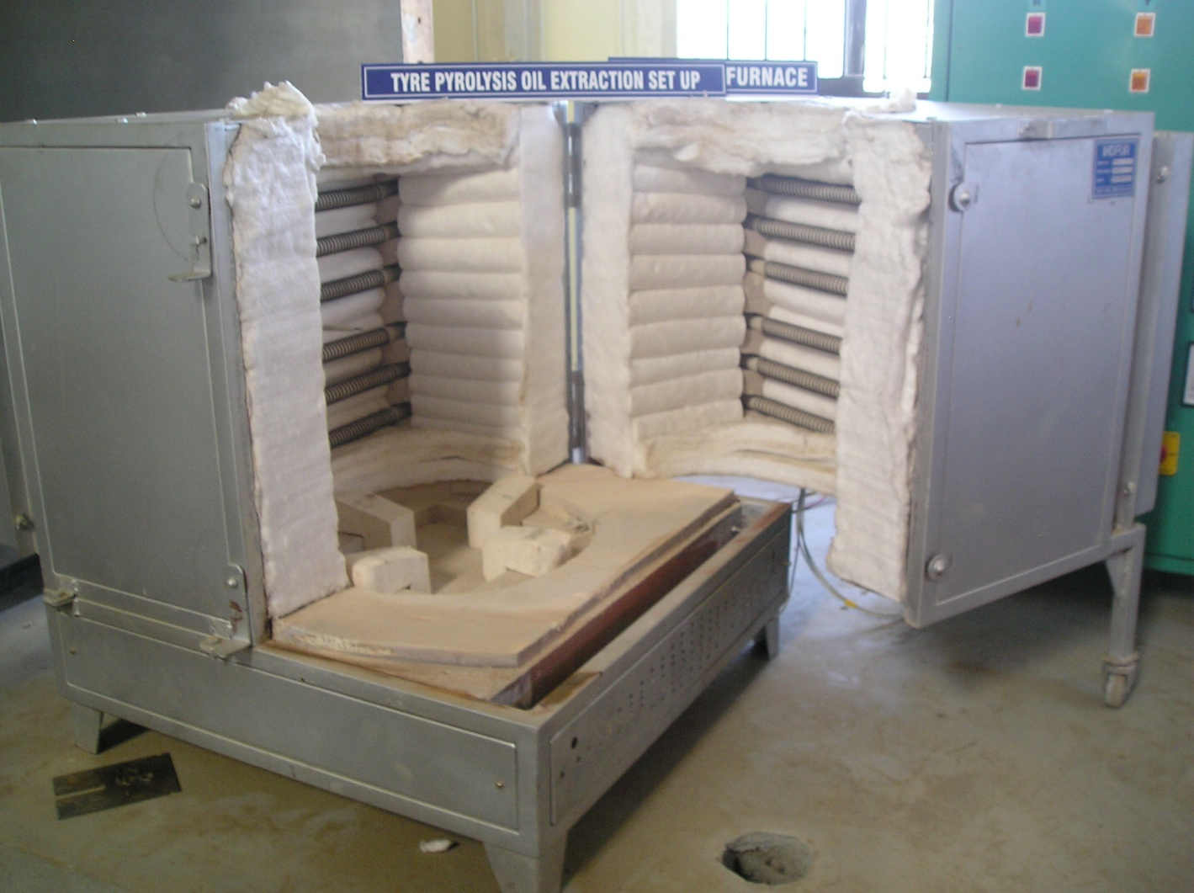
Heating furnace

Slide 24
Heat Diffusion Equation, Boundary Conditions and Initial Conditions

Slide 25
The Heat Diffusion Equation
Objective: To determine T = f (x, y, z, t) for given b.c.’s and i.c.
Homogeneous medium in 3-D Cartesian coordinates
Differential control volume, dx, dy, dz for conduction analysis in 3-D Cartesian coordinates
q_{z+dz}
q_{y+dy}
dz
q_{x}
q_{x+dx}
z
y
x
dy
dx
same for y and z directions
q_{y}
q_{z}

Slide 26
Conservation of Energy:
Heat diffusion equation in 3-D Cartesian coordinates, for constant k
For 1-D, steady state (∂T/∂t = 0) heat conduction with no energy generation :
Which means that , or q_{x}’’ = Constant
where

Slide 27
One-Dimensional Steady State Conduction
The Plane Wall
a) Temperature Distribution
1-D, steady state heat conduction through a slab with no heat generation and with constant thermal properties
Find: 1. Temperature distribution (T=f(x)) along wall thickness
2. Heat flux q_{x}” through the wall
Procedure:
Establish the coordinate system
Solve the heat equation using appropriate B.C.’s ⇒ T= f (x)
Estimate q” from Fourier’s Law
T_{∞,1}
Appropriate governing equation:
T _{s,1}
hot fluid
T _{s,2}
cold fluid
q_{x}
h₂
h₁
T_{∞,2}
L
x=0

Slide 28
Integrating twice we get
B.C. #1:
At x = 0, T = T_{s,1} = C₂
B.C. #2
At x = L, T = T_{s,2} = C₁L+C₂ ⇒ C₁=(T_{s,2} - T_{s,1})/L
Solution:
To estimate the heat transfer rate (q_{x}), use Fourier’s Law:
I
q
R
K/W
∆V
∆ T

Slide 29
b) Thermal resistance
In general, resistance
Electrical
Thermal
For the plane wall
T_{∞,1}
T _{s,1}
h₁
T _{s,2}
h₂
q_{x}
T_{∞,2}
L
q_{x}
T_{∞,1}
T _{s,1}
T _{s,2}
T_{∞,2}
Thermal circuit:
Calculate q, knowing T∞ ?

Slide 30
U
Overall heat transfer coefficient (U)
where
UA has units of W / K
R_{t} has units of K / W
R_{t}” has units K m² / W

Slide 31
c) The composite wall
T_{∞,1}
T _{s,1}
T _{s,2}
T _{s,3}
Hot fluid
h₁
Cold fluid
k_{A}
k_{B}
k_{C}
T _{s,4}
h₂
T_{∞,2}
L_{A}
L_{B}
L_{C}
q_{x}
T_{∞,1}
T _{s,1}
T _{s,2}
T _{s,3}
T _{s,4}
T_{∞,2}
where

Slide 32
d) Series-Parallel composite wall
T₁
k_{B}, A_{B}
k_{A},
A_{A}
k_{D} ,
A_{D}
k_{C}, A_{C}
T₂
L_{A}
L_{B}=L_{C}
L_{D}
q_{x}
T₁
T₂
This assume surfaces normal to the x direction are isothermal
Are there other possible circuits?

Slide 33
Parallel only
T₁
k_{B}, A_{B}
k_{A},
A_{A}
k_{D} ,
A_{D}
k_{C}, A_{C}
T₂
L_{A}
L_{B}=L_{C}
L_{D}
This assume surfaces parallel to the x direction are adiabatic
q_{x}
T₁
T₂

Slide 34
e) Contact resistance (R_{t,cont}”)
Temperature drop (T_{A} – T_{B}) due to a contact resistance
Contact resistance is primarily due to surface roughness effects because gaps are filled with fluid (air)
T_{A}
For a unit area of the interface,
∆T
Gap
q”_{contact}
q”_{x}
Examples (see Tables 3.1 and 3.2):
1. Metallic Interfaces under vacuum
Aluminum-Aluminum under 100 kN/m²
R _{t,cont}” ≈ 1.5 – 5.0 x 10⁻⁴ m² K / W
2. Metallic Interfaces with different interfacial fluids
Aluminum (10 μm roughness) – Air
R _{t,cont}” ≈ 2.75 x 10⁻⁴ m² K / W
3. Solid/Solid interface
Silicone chip/Aluminum with 0.02-mm epoxy
R _{t,cont}” ≈ 0.2 – 0.9 x 10⁻⁴ m² K / W
q”_{gap}
T_{B}
T
x
A
B

Slide 35
2. Alternative Conduction Analysis Method
Standard Analysis Method
Appropriate heat equation is solved to obtain the required temperature distribution, and Fourier’s Law is subsequently applied to obtain the heat transfer rate
Alternative Analysis Method
Exclusive application of Fourier’s Law (i.e., no heat equation applied in the analysis)
Integration of Fourier’s Law over the domain
Assumptions
Steady-State conduction with no heat generation
Negligible heat losses form the sides
Constant heat transfer rate, q_{x}
1-D temperature distribution
A=f(x) and k=f(T)

Slide 36
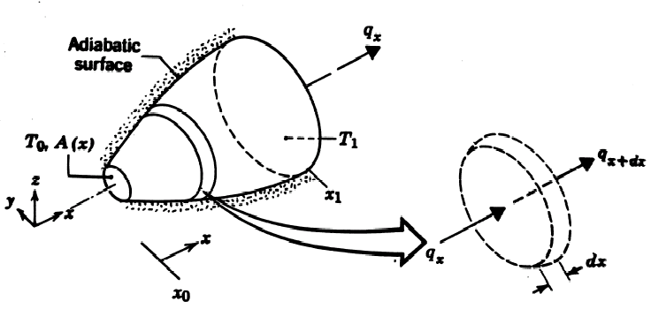
Integrating the above equation with the b.c.’s noted in the schematic
T = T₀ at x = x₀ and
T = T₁ at x = x₁
q_{x} can be computed.
If A = constant and k = constant (Independent of T), then the above equation reduces to:
where ∆x = x₁ – x₀ and ∆T = T₁ – T₀
or

Slide 37
3. Radial Systems
Cold Fluid
h₂, T_{∞,2}
Hot Fluid
h₁, T_{∞,1}
r₂
T _{s,1}
r₁
L
T _{s,2}
Hollow cylinder with convective surface conditions

Slide 38
a) Cylinder
Cold Fluid
h₂, T_{∞,2}
T _{s,1}
T_{∞,1}
T _{s,2}
r₁
Hot Fluid
h₁, T_{∞,1}
T_{∞,2}
r₂
T_{∞,1}
T _{s,1}
T _{s,2}
T_{∞,2}
q_{x}

Slide 39
Appropriate Heat Equation (1-D)
Assumptions:
Hollow cylinder
Steady-state conditions
No heat generation
Constant k
Integrating the above equation twice gives the general solution (G.S.):
T (r) = C₁ ln (r) + C₂
with the boundary conditions (b.c.’s):
T (r) = T_{s,1} and T (r) = T_{s,2}
radial direction only

Slide 40
Applying the b.c.’s in the G.S, solving for C₁ & C₂ and substituting in the G.S. results in the following radial temperature distribution:
or
where

Slide 41
T_{s,4}
Composite
Cylinder
T₃
T₂
T_{s,1}
r₁
r₂
r₃
T_{∞,1}, h₁
r₄
A
B
C
T_{∞,4}, h₄
q_{r}
T_{∞,1}
T _{s,1}
T₂
T ₃
T _{s,4}
T_{∞, 4}

Slide 42
Critical Insulation Thickness
Practically, it turns out that adding insulation in cylindrical and spherical exposed walls can initially cause the thermal resistance to decrease, thereby increasing the heat transfer rate because the outside area for convection heat transfer is getting larger. At some critical thickness, r_{cr}, the thermal resistance increases again and consequently the heat transfer is reduced.
To find an expression for r_{cr}, consider the thermal circuit below for an insulated cylindrical wall with thermal conductivity k:
q_{r}
T₁
T _{s}
T∞
r₂
Insulation
T∞ , h
r₁
Thin wall
T_{s}
R_{t}’

Slide 43
To find r_{cr}, set the overall thermal resistance dR_{t}’/dr = 0 and solve for r:
For insulation thickness less that r_{cr} the heat loss increases with increasing r and for insulation thickness greater that r_{cr} the heat loss decreases with increasing r
If k = 0.03 W/(m·K) and h = 10 W/(m²·K):
cylinder
sphere
r_{i} = inner radius
Similarly for a sphere

Slide 44
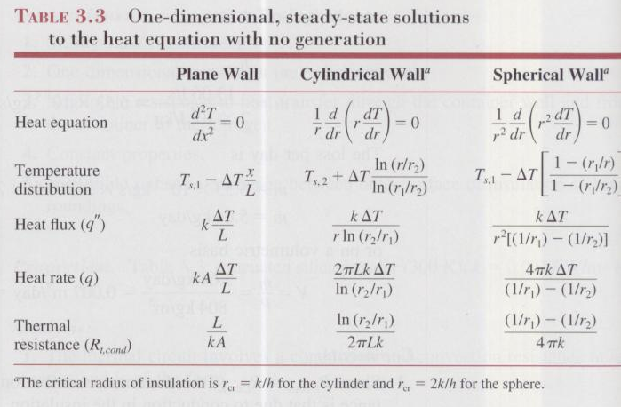
Summary
Table 3.3

Slide 45
1.A mild steel tank of wall thickness 12 mm contains water at 95ºC. The thermal conductivity of mild steel is 50 W/mk, and the heat transfer co-efficients of inside and outside are 2850 and 10 W/m²K. If the atmospheric temperature is 15ºC. Calculate : The rate of heat loss per m² of the tank and temperature at inner side and outer side of the tank.
2.A metal plate of 4mm thickness is exposed to vapour at 100ºC on one side and cooling water at 25ºC on the other side. The thermal conductivity of plate is 95.50 W/mk, and the heat transfer co-efficients on vapour side and water side14500 and 2250 W/m²K. Calculate : The rate of heat loss per m² of the tank and temperature drop at each side of the heat transfer.

Slide 46
3. Determine the heat loss for an insulated pipe carrying a hot liquid, to the surroundings per metre length of the pipe, given the following particulars. I.D. of the pipe = 10 cm, Wall thickness= 1 cm, Thickness of insulation= 3 cm. Temperature of hot liquid= 85ºC. K for steel= 58 W/mk, k for insulating material= 0.2 W/mk convective heat transfer co-efficient for inside and outside are 720 and 9 W/m²K. If the atmospheric temperature is 15ºC. Find interface temperatures.
4.A steel pipe line (k= 50 w/mK) of inner dia 100mm and outer dia 110mm is to be covered with 2 layers of insulation each having thickness of 50mm. K for first insulation is 0.06 w/mK and for second is 0.12w/mk. Calculate the heat loss per metre length of the pipe and interface temperatures if the inside tube surface is 250ºC and outside surface of insulation is 50ºC. If the order of insulation materials is reversed, calculate the heat loss percentage.

Slide 47
5.A steam pipe with (k = 45 W/mk) having 70 mm inside dia and 85 mm outside dia is lagged with 2 insulation layers, the layer in contact with the pipe is 35mm thick asbestos (k= 0.15 W/mk) and it is covered with 25mm thick magnesia insulation ( k= 0.075 W/mk). the convective heat transfer co-efficient for inside and outside are 220 and 6 W/m²K. If the temperature of the steam is 350ºC and atmospheric temperature is 30ºC. Find interface temperatures, Steady loss of heat for 50m length of the pipe, overall heat transfer co-efficient based inside and outside surfaces of the lagged steam main.
6. Determine the thermal conductivity of asbestos powder packed in between 2 concentric pipes of 25 and 36 mm diameter length. The inner pipe housing has a heating coil to which 120 W power is supplied. The average temperature of the inner and outer pipes are 42.4 and 27.9ºC respectively.

Slide 48
7. A spherical shaped vessel of 1.4 m dia is 90 mm thick. Find the rate of heat leakage, if the temperature difference between the inner and outer surfaces is 220ºC the thermal conductivity of the sphere is 0.083 W/mK.
8. A spherical thin walled metallic container is used to store liquid nitrogen at -196ºC. The container has a dia of 0.5m and is covered with insulation composed of silica powder. The insulation is 25mm thick and its outer layer is exposed to air at 27ºC. The convective heat transfer co-efficient on the outer surface is 20w/m²K. If k= 0.0017 W/mK for silica powder. Find the heat loss.
9. Determine the rate of heat flow through a spherical boiler wall which is 2m in dia and 2 cm thick(k=58 W/mK). The outer surface of boiler wall is covered with asbestos (k= 0.0116 W/mK) 5mm thick. The temperature of outer surface and that of the fluid are 50ºC and 300ºC respectively. Take inner film resistance as 0.0023 K/W.

Slide 49
10. Calculate the critical radius of insulation for asbestos (k= 0.172 W/mK) surrounding a pipe and exposed to room air at 300K with h=2.8 W/m²K. Calculate the heat loss from a 475K, 60 mm dia pipe when covered with the critical radius of insulation and without insulation.
11. A small electric heating application uses wire of 2mm dia with 0.8 mm with thick insulation (k= 0.12 w/mK). The heat transfer co-efficient on the insulated surface is 35 W/m²K. Determine the critical thickness of insulation in this case and the percentage change in the heat transfer rate if the critical thickness is used, assuming the temperature difference between the surface of the wire and surrounding air remains unchanged.
12. A wire of 6.5 mm dia at a temperature of 60º C is to be insulated by a material having k= 0.174 w/mK. Convection heat transfer co-efficient is 8.722 w/m²K. The ambient temperature is 20ºC. For maximum heat loss what is the minimum thickness of insulation and heat loss per metre length? Also find the percentage increase in the heat dissipation too.

Slide 50
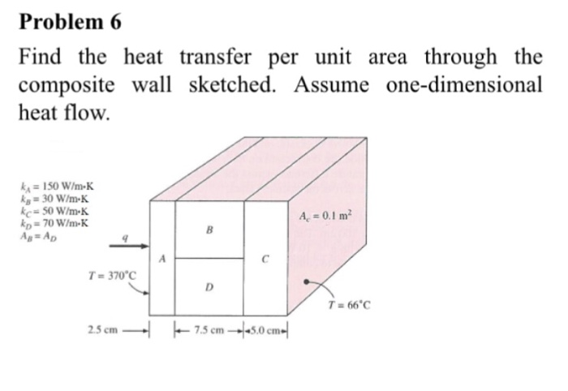

Slide 51
A furnace wall is made up of 3 layers of thicknesses 250mm, 100mm and 150mm respectively. The thermal conductivities of the inner and outer layers are 1.65 and 9.2 W/mK respectively. The inside is exposed to gases at 1250ºC with a convection co-efficient of 25 W/m²K and the inside surface is at1100 ºC, the outside surface is exposed to air at 25 ºC with a convection coefficient of 12 W/m²K. Determine the thermal conductivity of the middle layer, heat transferred per unit area and interface temperatures.

